Slide 1
Chapter 1
Fundamentals of
the Analysis of Algorithm Efficiency

Slide 2

The Asymptotic Efficiency of Algorithms:
Define the running time of a program T(n) as
a function f(n) of the size of its input, (i.e, T(n) ∞ f(n)).
The running time of an algorithm
increases in the limit, as the size of the input increases without bound.
Let N = {0, 1, 2, …} be the set of natural numbers.
[non-negative integer 0, 1, .. ;
positive integer 1, 2, .. . (traditional way)]

Slide 3
The Asymptotic Efficiency of Algorithms:
The asymptotic running time of an algorithm T(n) is defined in terms of functions f whose domains are the set of natural numbers.
How to describe the worst-case running-time function f(n) , defined only on integer input sizes?

Slide 4

Example 1.1:
The worst-case running time of insertion sort is
T(n) = Ɵ(n²),
as the input size n becomes large enough.
The worse-case running time of merge sort is
T(n) = Ɵ(nlog₂n).

Slide 5
Asymptote
The word asymptote (ˈæsɪmptoʊt) is derived from the Greek ἀσύμπτωτος (asumptotos) which means "not falling together," from ἀ priv. + σύν "together" + πτωτ-ός "fallen."
In analytic geometry, an asymptote of a curve is a line such that the distance between the curve and the line approaches zero as they tend to infinity.
In some contexts, such as algebraic geometry, an asymptote is defined as a line which is tangent to a curve at infinity.

Slide 6
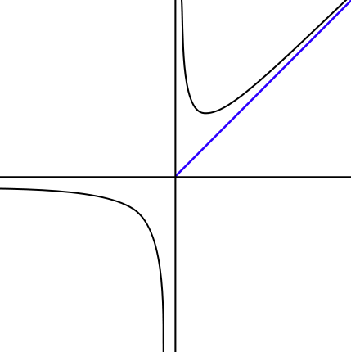
Asymptote: A line whose distance to a given curve tends to zero. An asymptote may or may not intersect its associated curve.
f(n)
The graph of a function with a horizontal (y = 0), vertical (x = 0), and oblique (x = y) asymptotes.

Slide 7
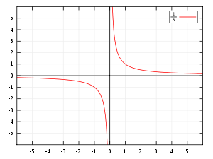

f(x)
graphed on Cartesian coordinates. The x and y-axes are the asymptotes.

Slide 8
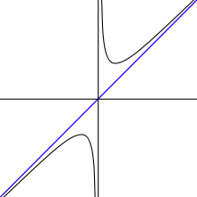

f(x)
In the graph of , the y-axis (x = 0) and the line y= x are both asymptotes. The function f(x) is asymptotic to x = 0 and y = x.

Slide 9
In mathematical analysis, asymptotic analysis is
a method of describing limiting behavior;
about the comparison of functions as inputs approach infinity.
Examples are
In the analysis of algorithms of computer science, considering the performance of algorithms when applied to very large input datasets
The behavior of physical systems when they are very large.

Slide 10
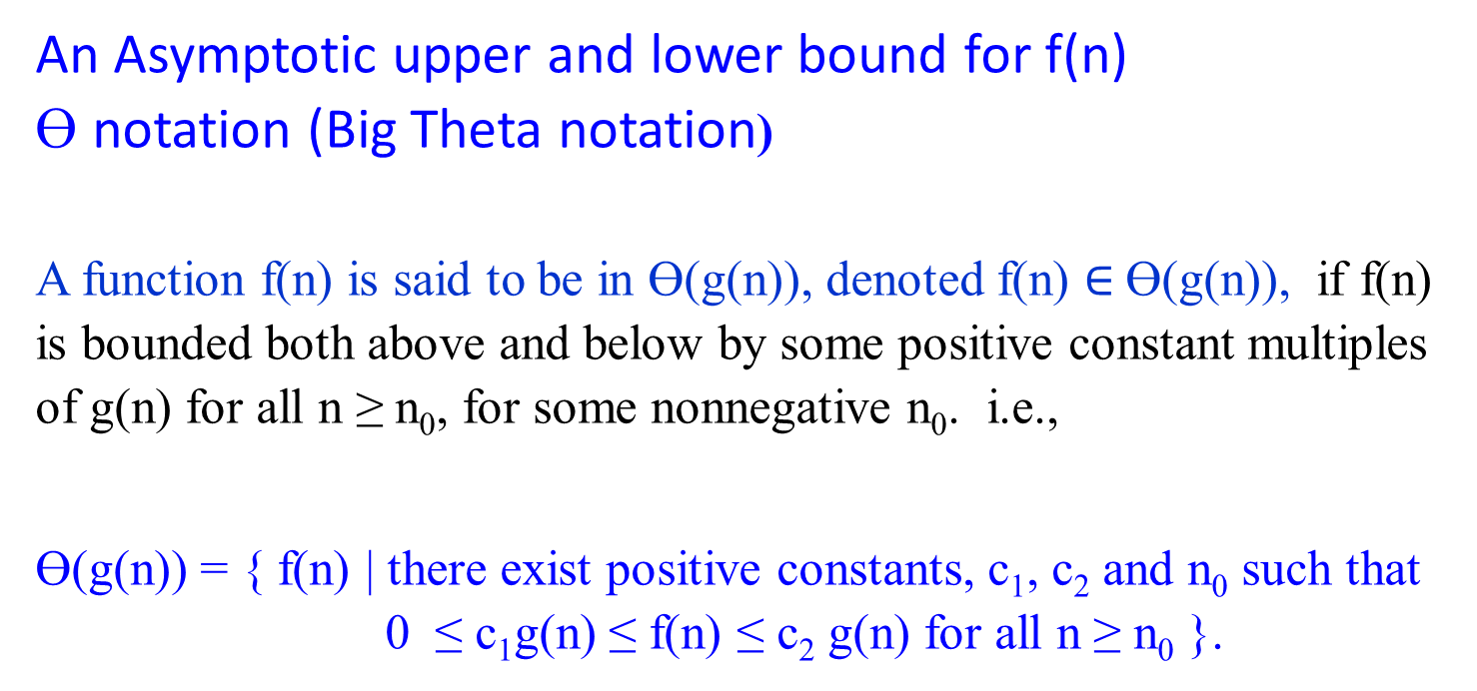
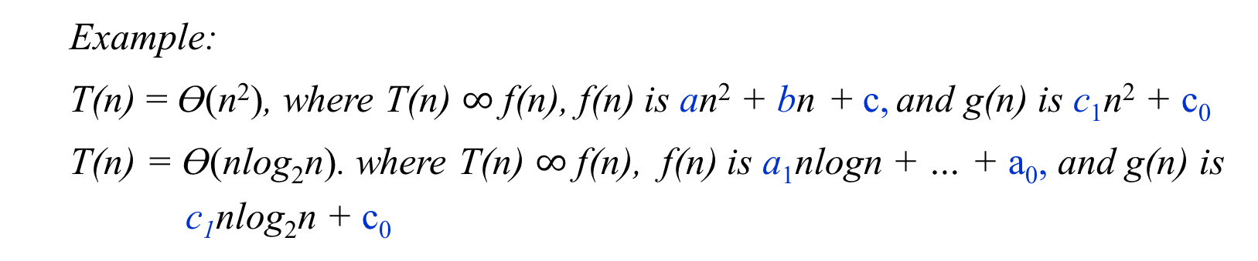
An Asymptotic upper and lower bound for f(n)
Ɵ notation (Big Theta notation)
A function f(n) is said to be in Ɵ(g(n)), denoted f(n) $∈$Ɵ(g(n)), if f(n) is bounded both above and below by some positive constant multiples of g(n) for all n ≥ n₀, for some nonnegative n₀. i.e.,
Ɵ(g(n)) = { f(n) | there exist positive constants, c₁, c₂ and n₀ such that 0 ≤ c₁g(n) ≤ f(n) ≤ c₂ g(n) for all n ≥ n₀ }.
Example:
T(n) = Ɵ(n²), where T(n) $∞$ f(n), f(n) is an² + bn + c, and g(n) is c₁n² + c₀
T(n) = Ɵ(nlog₂n). where T(n) $∞$ f(n), f(n) is a₁nlogn + … + a₀, and g(n) is
c₁nlog₂n + c₀

Slide 11
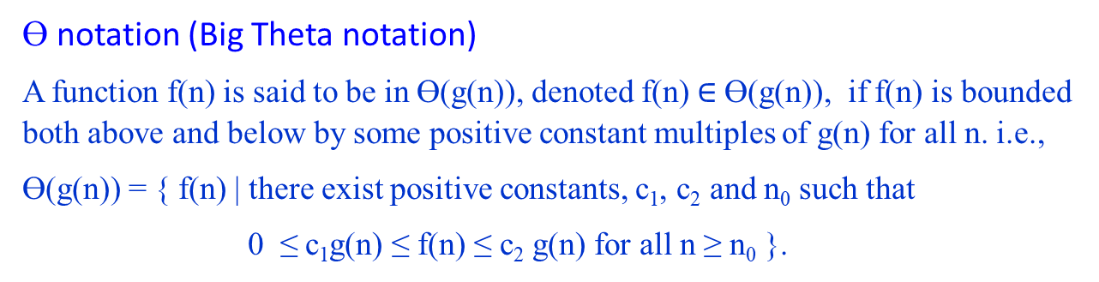

Ɵ notation (Big Theta notation)
A function f(n) is said to be in Ɵ(g(n)), denoted f(n) $∈$Ɵ(g(n)), if f(n) is bounded both above and below by some positive constant multiples of g(n) for all n. i.e.,
Ɵ(g(n)) = { f(n) | there exist positive constants, c₁, c₂ and n₀ such that
0 ≤ c₁g(n) ≤ f(n) ≤ c₂ g(n) for all n ≥ n₀ }.
c₂g(n)
f(n)
c₁g(n)
n₀ f(n) $∈$ Θ(g(n))
Figure 1.2(a) Θ-notation bounds a function to within constant factors. We write f(n) = Θ(g(n)) if there exist positive constant n₀, c₁ and c₂ such that to the right of the minimum possible value n₀, the value of f(n) always lies between c₁g(n) and c₂g(n) inclusive.

Slide 12

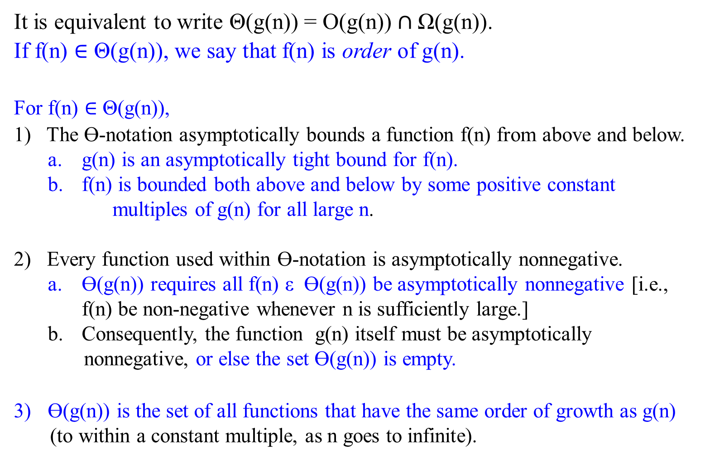
It is equivalent to write Θ(g(n)) = O(g(n)) $∩$Ω(g(n)).
If f(n) $∈$ Θ(g(n)), we say that f(n) is order of g(n).
For f(n) $∈$ Θ(g(n)),
1) The Ɵ-notation asymptotically bounds a function f(n) from above and below.
g(n) is an asymptotically tight bound for f(n).
f(n) is bounded both above and below by some positive constant
multiples of g(n) for all large n.
2) Every function used within Ɵ-notation is asymptotically nonnegative.
Ɵ(g(n)) requires all f(n) ε Ɵ(g(n)) be asymptotically nonnegative [i.e., f(n) be non-negative whenever n is sufficiently large.]
Consequently, the function g(n) itself must be asymptotically
nonnegative, or else the set Ɵ(g(n)) is empty.
Ɵ(g(n)) is the set of all functions that have the same order of growth as g(n)
(to within a constant multiple, as n goes to infinite).

Slide 13
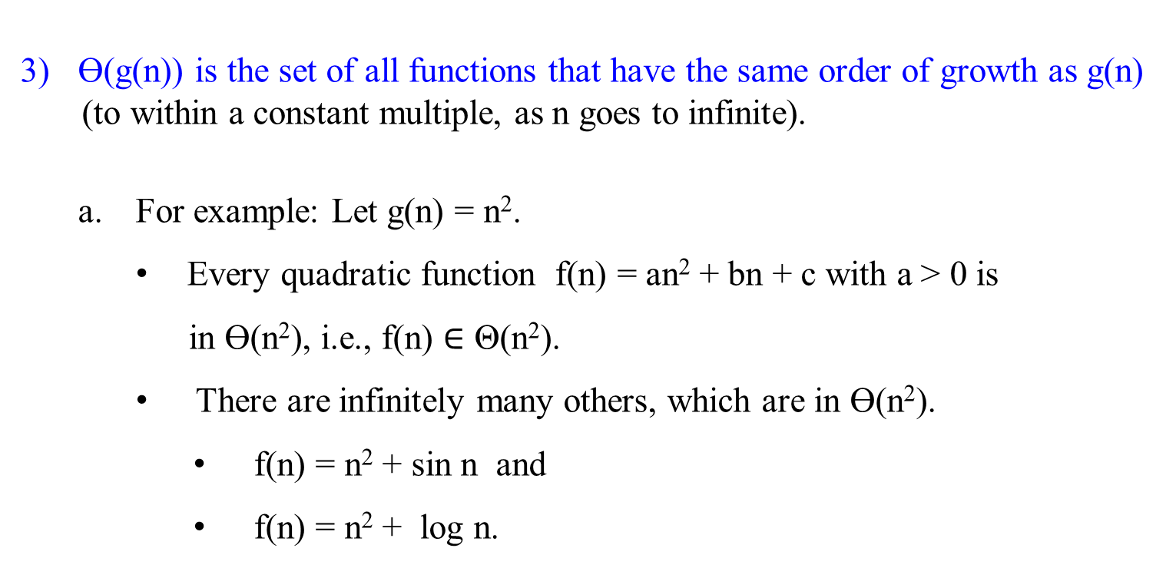
Ɵ(g(n)) is the set of all functions that have the same order of growth as g(n)
(to within a constant multiple, as n goes to infinite).
For example: Let g(n) = n².
Every quadratic function f(n) = an² + bn + c with a > 0 is
in Ɵ(n²), i.e., f(n) $∈$ Θ(n²).
There are infinitely many others, which are in Ɵ(n²).
f(n) = n² + sin n and
f(n) = n² + log n.

Slide 14
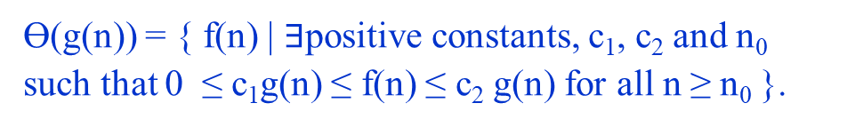
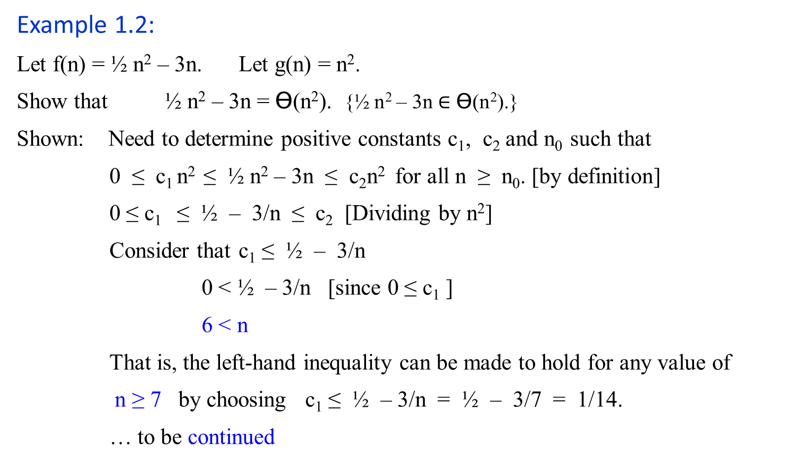
Ɵ(g(n)) = { f(n) | $∃$positive constants, c₁, c₂ and n₀ such that 0 ≤ c₁g(n) ≤ f(n) ≤ c₂ g(n) for all n ≥ n₀ }.
Example 1.2:
Let f(n) = ½ n² – 3n. Let g(n) = n².
Show that ½ n² – 3n = Ɵ(n²). {½ n² – 3n $∈$ Ɵ(n²).}
Shown: Need to determine positive constants c₁, c₂ and n₀ such that
0 ≤ c₁ n² ≤ ½ n² – 3n ≤ c₂n² for all n ≥ n₀. [by definition]
0 ≤ c₁ ≤ ½ – 3/n ≤ c₂ [Dividing by n²]
Consider that c₁ ≤ ½ – 3/n
0 < ½ – 3/n [since 0 ≤ c₁ ]
6 < n
That is, the left-hand inequality can be made to hold for any value of
n ≥ 7 by choosing c₁ ≤ ½ – 3/n = ½ – 3/7 = 1/14.
… to be continued

Slide 15
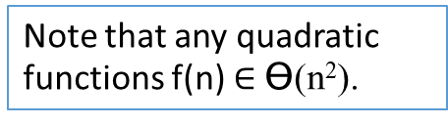
Example 1.2:
Let f(n) = ½ n² – 3n. Let g(n) = n².
Show that ½ n² – 3n = Ɵ(n²).
Shown: Continue …
Consider that ½ – 3/n ≤ c₂.
c₂ ≥ ½ as n is very large.
The right-hand inequality can be made to hold for any value of n ≥ 1 by choosing c₂ ≥ ½ .
Thus, by choosing c₁ = 1/14, c₂ = ½ and n₀ = 7, we verify that ½n² – 3n = Ɵ(n²). QED.
Note that any quadratic functions f(n) $∈$ Ɵ(n²).
Note that 1) Other choices for the constants exits.
2) A different function belonging to would usually require different constants.

Slide 16
Let f(n) = ½ n² – 3n. Let g(n) = n². c₁ = 1/14 = 0.071428571
n | ½ n² – 3n | n² | 0.07 n² | 0.5 n²
0 | 0 | 0 | 0 | 0
1 | -2.5 | 1 | 0.07 | 0.5
2 | -4 | 4 | 0.28 | 2
4 | -4 | 16 | 1.12 | 8
5 | -2.5 | 25 | 1.75 | 12.5
6 | 0 | 36 | 2.52 | 18
7 | 3.5 | 49 | 3.43 | 24.5
8 | 8 | 64 | 4.48 | 32
9 | 13.5 | 81 | 5.67 | 40.5
10 | 20 | 100 | 7 | 50
11 | 27.5 | 121 | 8.47 | 60.5
12 | 36 | 144 | 10.08 | 72
13 | 45.5 | 169 | 11.83 | 84.5
14 | 56 | 196 | 13.72 | 98
15 | 67.5 | 225 | 15.75 | 112.5
16 | 80 | 256 | 17.92 | 128
17 | 93.5 | 289 | 20.23 | 144.5
18 | 108 | 324 | 22.68 | 162
19 | 123.5 | 361 | 25.27 | 180.5
20 | 140 | 400 | 28 | 200
25 | 237.5 | 625 | 43.75 | 312.5
30 | 360 | 900 | 63 | 450
40 | 680 | 1600 | 112 | 800
50 | 1100 | 2500 | 175 | 1250
60 | 1620 | 3600 | 252 | 1800
70 | 2240 | 4900 | 343 | 2450
80 | 2960 | 6400 | 448 | 3200
90 | 3780 | 8100 | 567 | 4050
100 | 4700 | 10000 | 700 | 5000
200 | 19400 | 40000 | 2800 | 20000
500 | 123500 | 250000 | 17500 | 125000
1000 | 497000 | 1000000 | 70000 | 500000
5000 | 12485000 | 25000000 | 1750000 | 12500000
10000 | 49970000 | 100000000 | 7000000 | 50000000
20000 | 199940000 | 400000000 | 28000000 | 200000000
50000 | 1249850000 | 2500000000 | 175000000 | 1250000000
100000 | 4999700000 | 10000000000 | 700000000 | 5000000000

Slide 17

Let f(n) = ½ n² – 3n. Let g(n) = n². c₁ = 1/14 = 0.071428571 and c₂ = ½
n | ½ n² – 3n | n² | 0.07 n² | 0.5 n²
0 | 0 | 0 | 0 | 0
1 | -2.5 | 1 | 0.07 | 0.5
2 | -4 | 4 | 0.28 | 2
4 | -4 | 16 | 1.12 | 8
5 | -2.5 | 25 | 1.75 | 12.5
6 | 0 | 36 | 2.52 | 18
7 | 3.5 | 49 | 3.43 | 24.5
8 | 8 | 64 | 4.48 | 32
9 | 13.5 | 81 | 5.67 | 40.5
10 | 20 | 100 | 7 | 50
11 | 27.5 | 121 | 8.47 | 60.5
12 | 36 | 144 | 10.08 | 72
13 | 45.5 | 169 | 11.83 | 84.5
14 | 56 | 196 | 13.72 | 98
15 | 67.5 | 225 | 15.75 | 112.5
16 | 80 | 256 | 17.92 | 128
17 | 93.5 | 289 | 20.23 | 144.5
18 | 108 | 324 | 22.68 | 162
19 | 123.5 | 361 | 25.27 | 180.5
20 | 140 | 400 | 28 | 200

Slide 18
Let f(n) = ½ n² – 3n. Let g(n) = n². c₁ = 1/14 = 0.071428571
n | ½ n² – 3n | n² | 0.07 n² | 0.5 n²
20 | 140 | 400 | 28 | 200
25 | 237.5 | 625 | 43.75 | 312.5
30 | 360 | 900 | 63 | 450
40 | 680 | 1600 | 112 | 800
50 | 1100 | 2500 | 175 | 1250
60 | 1620 | 3600 | 252 | 1800
70 | 2240 | 4900 | 343 | 2450
80 | 2960 | 6400 | 448 | 3200
90 | 3780 | 8100 | 567 | 4050
100 | 4700 | 10000 | 700 | 5000
200 | 19400 | 40000 | 2800 | 20000
500 | 123500 | 250000 | 17500 | 125000
1000 | 497000 | 1000000 | 70000 | 500000
5000 | 12485000 | 25000000 | 1750000 | 12500000
10000 | 49970000 | 100000000 | 7000000 | 50000000
20000 | 199940000 | 400000000 | 28000000 | 200000000
50000 | 1249850000 | 2500000000 | 175000000 | 1250000000
100000 | 4999700000 | 10000000000 | 700000000 | 5000000000

Slide 19
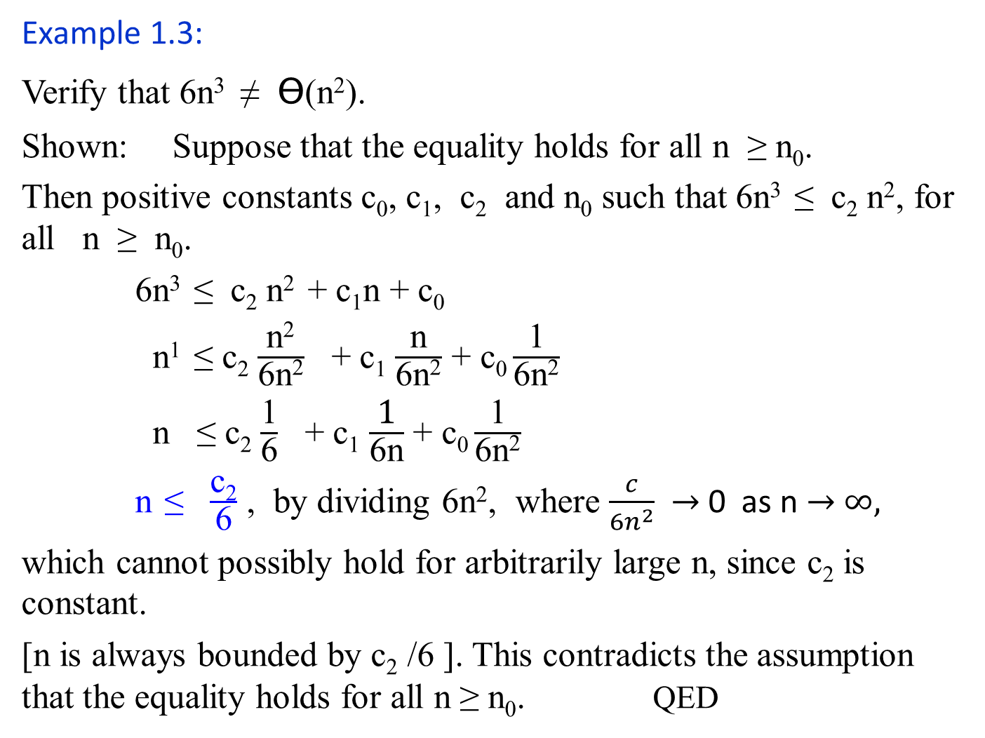
Example 1.3:
Verify that 6n³ ≠ Ɵ(n²).
Shown: Suppose that the equality holds for all n ≥ n₀.
Then positive constants c₀, c₁, c₂ and n₀ such that 6n³ ≤ c₂ n², for all n ≥ n₀.
6n³ ≤ c₂ n² + c₁n + c₀
n¹ ≤ c₂ $\frac{\text{n}\text{2}}{\text{6}\text{n}\text{2}}$ + c₁ $\frac{\text{n}}{\text{6}\text{n}\text{2}}$ + c₀ $\frac{\text{1}}{\text{6}\text{n}\text{2}}$
n ≤ c₂ $\frac{\text{1}}{\text{6}}$ + c₁ $\frac{\text{1}}{\text{6}\text{n}}$ + c₀ $\frac{\text{1}}{\text{6}\text{n}\text{2}}$
n ≤ $\frac{\text{c}\text{2}}{\text{6}}$ , by dividing 6n², where $\frac{c}{{6n}^{2}}$ $→$ 0 as n $→$ $∞,$
which cannot possibly hold for arbitrarily large n, since c₂ is constant.
[n is always bounded by c₂ /6 ]. This contradicts the assumption that the equality holds for all n ≥ n₀. QED
Ɵ(g(n)) = { f(n) | $∃$positive constants, c₁, c₂ and n₀ such that 0 ≤ c₁g(n) ≤ f(n) ≤ c₂ g(n) for all n ≥ n₀ }.

Slide 20
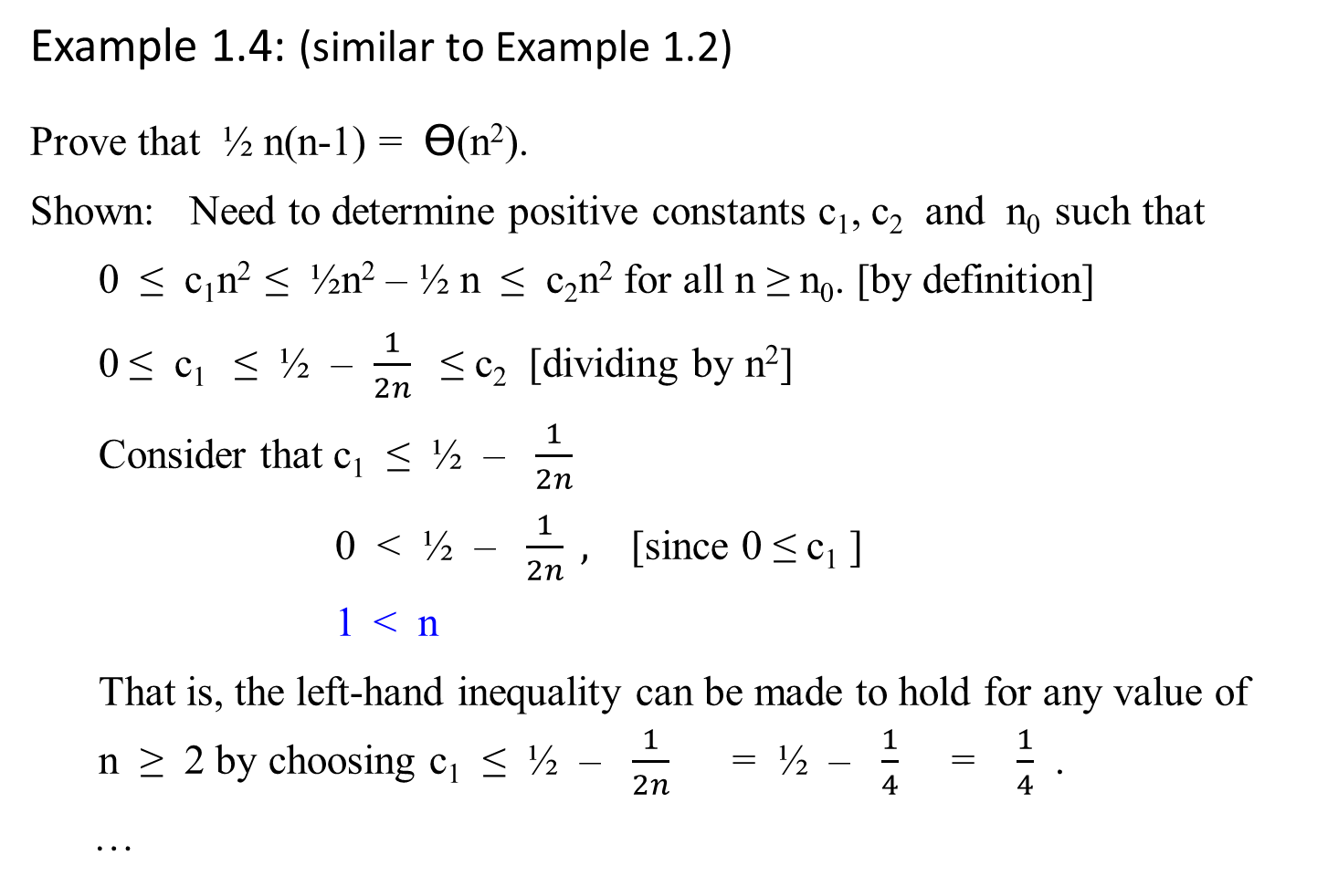
Example 1.4: (similar to Example 1.2)
Prove that ½ n(n-1) = Ɵ(n²).
Shown: Need to determine positive constants c₁, c₂ and n₀ such that
0 ≤ c₁n² ≤ ½n² – ½ n ≤ c₂n² for all n ≥ n₀. [by definition]
0 ≤ c₁ ≤ ½ – $\frac{1}{2n}$ ≤ c₂ [dividing by n²]
Consider that c₁ ≤ ½ – $\frac{1}{2n}$
0 < ½ – $\frac{1}{2n} ,$ [since 0 ≤ c₁ ]
1 < n
That is, the left-hand inequality can be made to hold for any value of n ≥ 2 by choosing c₁ ≤ ½ – $\frac{1}{2n}$ = ½ – $\frac{1}{4}$ = $\frac{1}{4}$ .
…

Slide 21
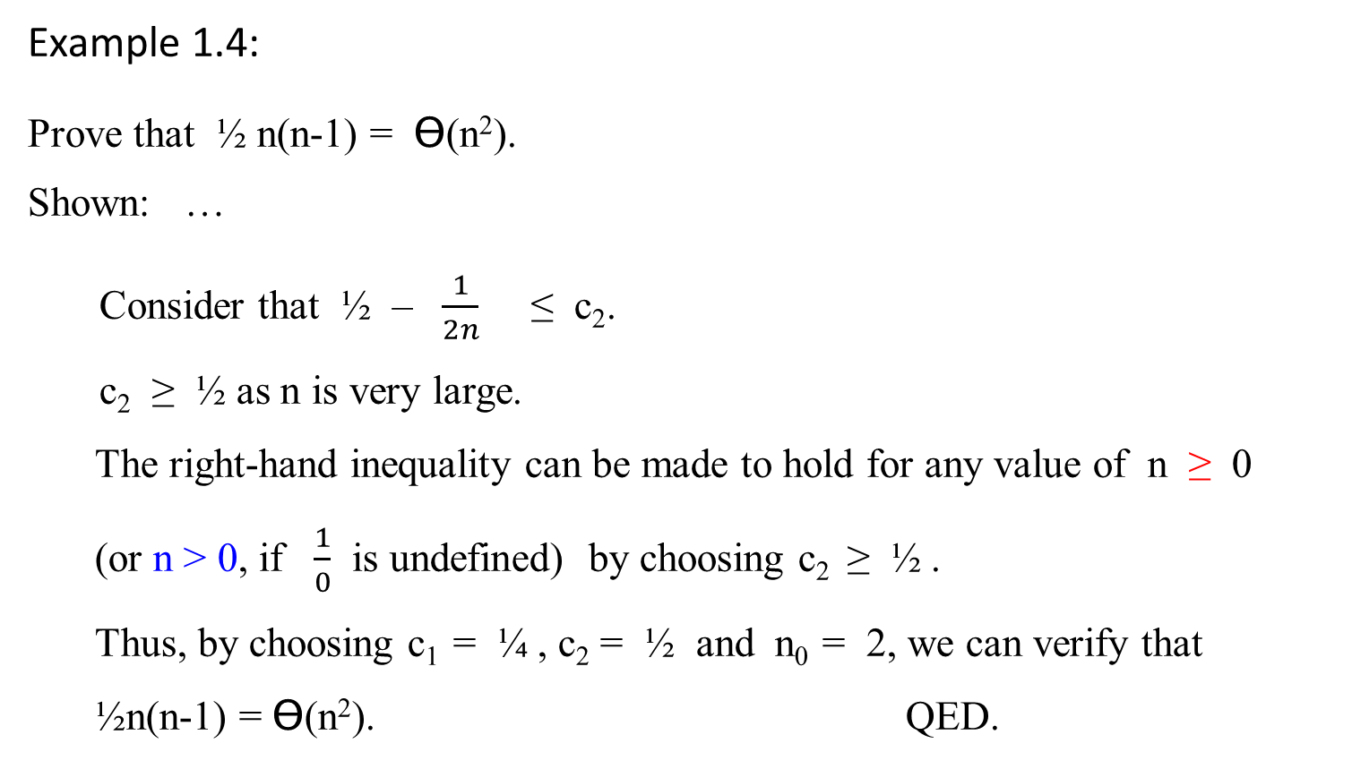
Example 1.4:
Prove that ½ n(n-1) = Ɵ(n²).
Shown: …
Consider that ½ – $\frac{1}{2n}$ ≤ c₂.
c₂ ≥ ½ as n is very large.
The right-hand inequality can be made to hold for any value of n ≥ 0
(or n > 0, if $\frac{1}{0}$ is undefined) by choosing c₂ ≥ ½ .
Thus, by choosing c₁ = ¼ , c₂ = ½ and n₀ = 2, we can verify that ½n(n-1) = Ɵ(n²). QED.

Slide 22
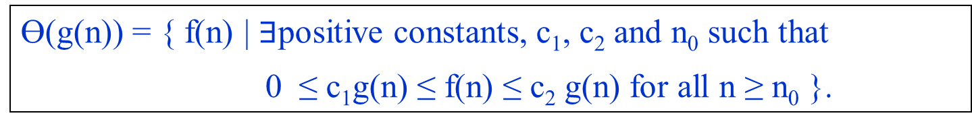

An Asymptotic upper bound for f(n)
O-notation (Big Oh notation, sometimes, Oh notation)
Big-oh of g of n
Definition:
A function f(n) is said to be in O(g(n)), denoted f(n) $∈$ O(g(n)), if f(n) is bounded above by some constant multiple of g(n) for all n ≥ n₀, for some nonnegative n₀. i.e.,
O(g(n)) = {f(n) | there exist positive constants c and n₀ such that 0 ≤ f(n) ≤ cg(n) for all n ≥ n₀.}
Ɵ(g(n)) = { f(n) | $∃$positive constants, c₁, c₂ and n₀ such that
0 ≤ c₁g(n) ≤ f(n) ≤ c₂ g(n) for all n ≥ n₀ }.

Slide 23

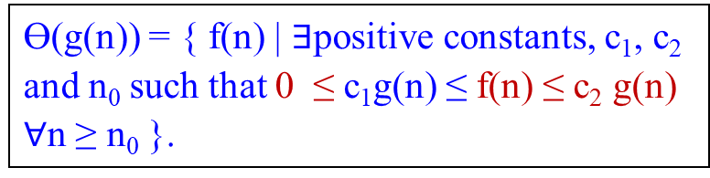
An Asymptotic upper bound for f(n)
O-notation (Big Oh notation)
Big-oh of g of n
For a given complexity function g(n),
O(g(n)) = {f(n) | there exist positive constants c and n₀ such that
0 ≤ f(n) ≤ cg(n) for all n ≥ n₀.}
Ɵ(g(n)) = { f(n) | $∃$positive constants, c₁, c₂ and n₀ such that 0 ≤ c₁g(n) ≤ f(n) ≤ c₂ g(n) $∀$n ≥ n₀ }.
cg(n)
f(n)
n₀ f(n) = O(g(n)) where c and n₀ are positive integer 1, 2, …
Figure 1.2. (b) O-notation gives an upper bound for a function to within a constant factor.
If f(n) $∈$ O(g(n)), we say that f(n) is big O of g(n).

Slide 24
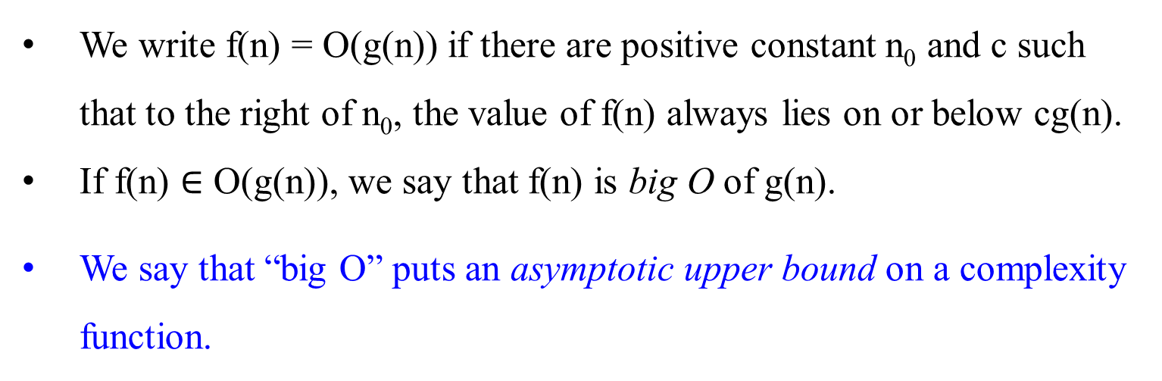
We write f(n) = O(g(n)) if there are positive constant n₀ and c such that to the right of n₀, the value of f(n) always lies on or below cg(n).
If f(n) $∈$ O(g(n)), we say that f(n) is big O of g(n).
We say that “big O” puts an asymptotic upper bound on a complexity function.

Slide 25
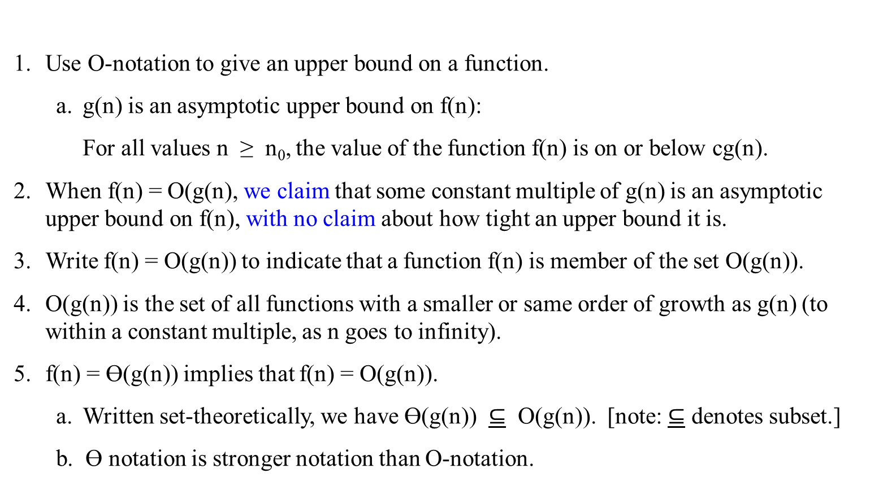
Use O-notation to give an upper bound on a function.
g(n) is an asymptotic upper bound on f(n):
For all values n ≥ n₀, the value of the function f(n) is on or below cg(n).
When f(n) = O(g(n), we claim that some constant multiple of g(n) is an asymptotic upper bound on f(n), with no claim about how tight an upper bound it is.
Write f(n) = O(g(n)) to indicate that a function f(n) is member of the set O(g(n)).
O(g(n)) is the set of all functions with a smaller or same order of growth as g(n) (to within a constant multiple, as n goes to infinity).
f(n) = Ɵ(g(n)) implies that f(n) = O(g(n)).
Written set-theoretically, we have Ɵ(g(n)) $⊆$ O(g(n)). [note: $⊆$ denotes subset.]
b. Ɵ notation is stronger notation than O-notation.

Slide 26
Example 1.5:
Prove that 100n + 5 = O(n²).
Proof: 100n + 5 ≤ 100n + n (for all n ≥ 5)
= 101n ≤ 101 n²
Thus, c = 101 and n₀ = 5.
Note that the definition gives us many choice for selecting constants c and n₀. For example:
100n + 5 ≤ 100n + 5n (for all n ≥ 1)
= 105n ≤ 105 n²
Thus, c = 105 and n₀ = 1.

Slide 27
Examples 1.6:
O(g(n)) is the set of all functions with a smaller or same order of growth as g(n) (to within a constant multiple, as n goes to infinity).
n ε O(n²). 100n + 5 ε O(n²). ½ n(n-1) ε O(n²).
On the other hand,
n³ ≠ O(n²). 0.00001n³ ≠ O(n²). n⁴ + n + 1 ≠ O(n²).

Slide 28
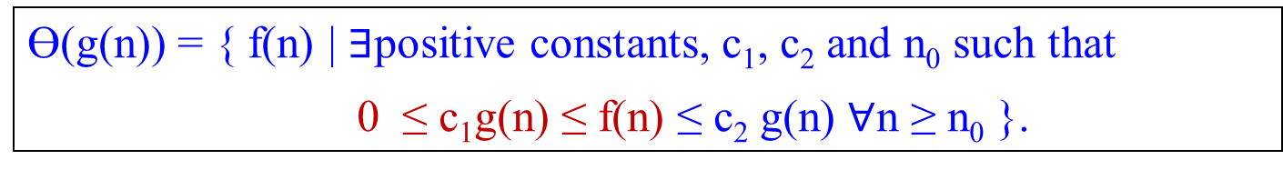

An Asymptotic lower bound on a function
Ω-notation (Big-omega of g of n)
Definition:
A function f(n) is said to be in Ω(g(n)), denoted f(n) $∈$ Ω(g(n)), if f(n) is bounded below by some constant multiple of g(n) for all n ≥ n₀, for some nonnegative n₀. i.e.,
Ω(g(n)) = { f(n) | there exist positive constants c and n₀ such that
0 ≤ cg(n) ≤ f(n) for all n ≥ n₀ }.
Ɵ(g(n)) = { f(n) | $∃$positive constants, c₁, c₂ and n₀ such that
0 ≤ c₁g(n) ≤ f(n) ≤ c₂ g(n) $∀$n ≥ n₀ }.

Slide 29

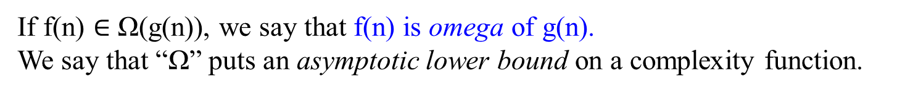
Figure 1.2. (c). Ω-notation gives a lower bound for a function to within a constant factor.
We write f(n) = Ω(g(n)) if there are positive constants n₀ and c such that to the right of n₀, the value of f(n) always lies on or above cg(n).
f(n)
asymptote
cg(n)
n₀ f(n) = Ω(g(n))
If f(n) $∈$ Ω(g(n)), we say that f(n) is omega of g(n).
We say that “Ω” puts an asymptotic lower bound on a complexity function.

Slide 30
Ω-notation describes a lower bound,
For all values n ≥ n₀, the value of f(n) is on or above cg(n).
When we use Ω-notation to bound the best-case running time of an algorithm, by implication we also bound the running time of the algorithm on arbitrary inputs as well.
For example,
the best-case running time of insertion sort is Ω(n), which implies that the running time of insertion sort is Ω(n).
2. Ω(g(n)) stands for the set of all functions with a larger or same order of growth as g(n) (to within a constant multiple, as n goes to infinity).
3. The running time of insertion sort therefore falls between Ω(n) and O(n²) since it falls anywhere between a linear function of n and a quadratic function of n
4. …

Slide 31
…
4. These bounds are asymptotically as tight as possible: for instance, the running time of insertion sort is not Ω(n²), since there exist an input for which insertion sort runs in Ɵ(n) time (e.g., when the input is already sorted).
5. It is not contradictory to say that the worst-case running time of insertion sort is Ω(n²), since there exists an input that cause the algorithm to take Ω(n²) time.
6. When we say that the running time (no modifier) of an algorithm is Ω(g(n)), we mean that no matter what particular input of size n is chosen for each value of n, the running time on that input is at least a constant time g(n), for sufficiently large n.

Slide 32
Example 1.7:
Prove that n³ = Ω(n²).
Proof: 0 ≤ n² ≤ n³ , for all n ≥ 0.
That is we can select c = 1 and n₀ = 0.
Example 1.8:
Ω(g(n)) stands for the set of all functions with a larger or same order of growth as g(n) (to within a constant multiple, as n goes to infinity).
n³ ε Ω (n²). ½ n(n-1) ε Ω (n²). But 100n + 5 ≠ Ω (n²).

Slide 33
Theorem 1.2:
For any two functions f(n) and g(n), we have f(n) = Ɵ(g(n)) if, and only if f(n) = O(g(n)) and f(n) = Ω(g(n)).
Proof: Followed by their definitions.
Example 1.9:
Our proof that an² + bn + c = Ɵ(n²) for any constant a, b and c, where a > 0, immediately implies that an² + bn + c = Ω(n²) and an² + bn + c = O(n²).

Slide 34
Insertion Sort
Algorithm Insertion-Sort(A[0..n-1])
//sorts a given array by insertion sort
//Input: An array A[0..n-1] of n orderable elements
//Output: Array A[0..n-1] sorted in nondecreasing order
for (i ← 1 to n – 1)
do {key ← A[i]
//Insert A[j] into the sorted sequence A[1 .. j-1].
j ← i – 1
while (j ≥ 0 and A[j] > key) do { A[j+1] ← A[j]
j ← j – 1 } //end doWhile
A[j+1] ← key; } //end doFor

Slide 35

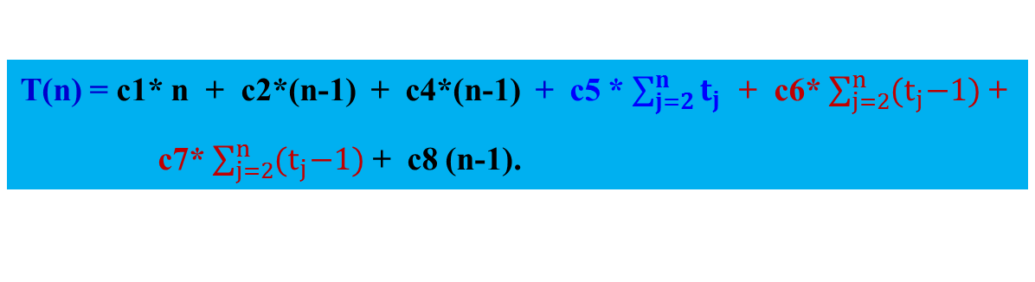
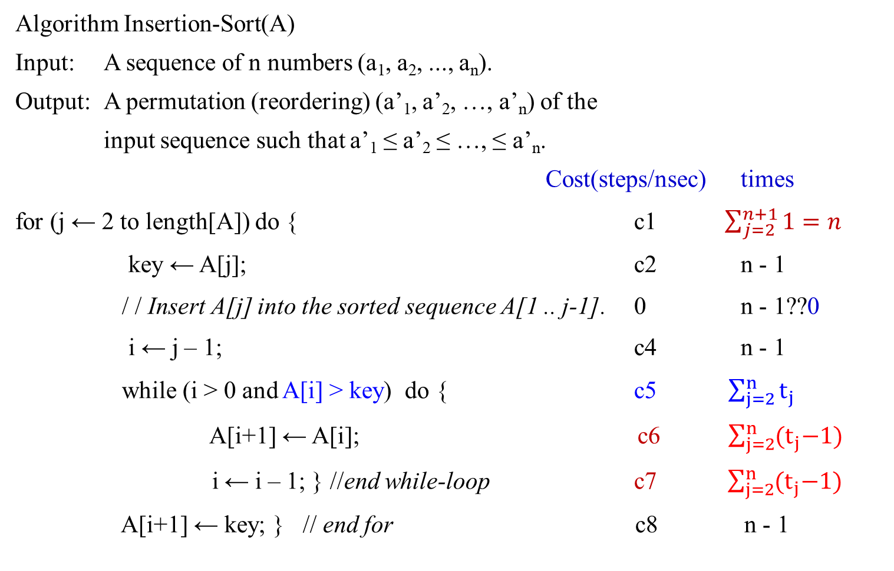
T(n) = c1* n + c2*(n-1) + c4*(n-1) + c5 * $\sum_{j=2}^{n}{t_{j}}$ + c6* $\sum_{j=2}^{n}{{(t}_{j}−1)}$ +
c7* $\sum_{j=2}^{n}{{(t}_{j}−1)}$ + c8 (n-1).
Algorithm Insertion-Sort(A)
Input: A sequence of n numbers (a₁, a₂, ..., a_{n}).
Output: A permutation (reordering) (a’₁, a’₂, …, a’_{n}) of the
input sequence such that a’₁ ≤ a’₂ ≤ …, ≤ a’_{n}.
Cost(steps/nsec) times
for (j ← 2 to length[A]) do { c1 $\sum_{j=2}^{n+1}{1=n}$
key ← A[j]; c2 n - 1
/ / Insert A[j] into the sorted sequence A[1 .. j-1]. 0 n - 1??0
i ← j – 1; c4 n - 1
while (i > 0 and A[i] > key) do { c5 $\sum_{j=2}^{n}{t_{j}}$
A[i+1] ← A[i]; c6 $\sum_{j=2}^{n}{{(t}_{j}−1)}$
i ← i – 1; } //end while-loop c7 $\sum_{j=2}^{n}{{(t}_{j}−1)}$
A[i+1] ← key; } // end for c8 n - 1

Slide 36

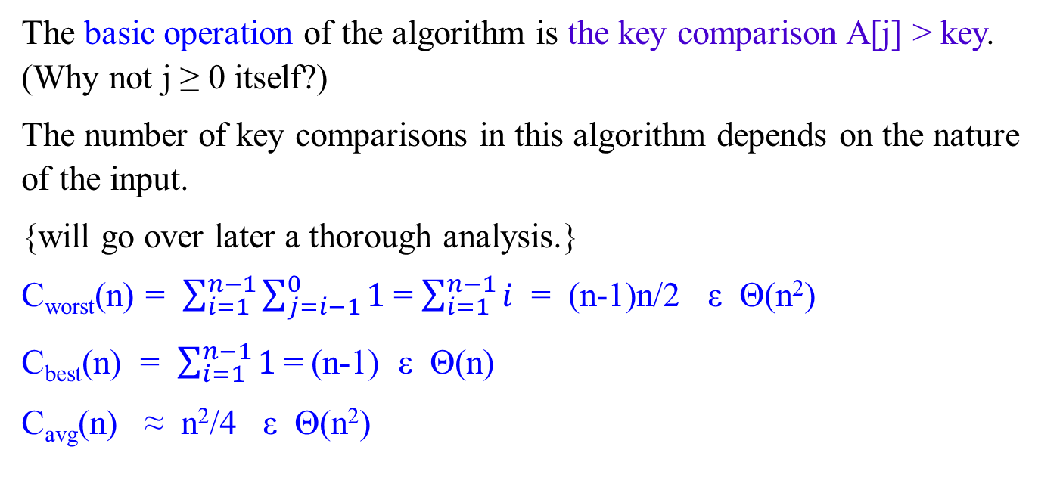
The basic operation of the algorithm is the key comparison A[j] > key. (Why not j ≥ 0 itself?)
The number of key comparisons in this algorithm depends on the nature of the input.
{will go over later a thorough analysis.}
C_{worst}(n) = $\sum_{i=1}^{n−1}{\sum_{j=i−1}^{0}{1}}$= $\sum_{i=1}^{n−1}{i}$ = (n-1)n/2 ε Θ(n²)
C_{best}(n) = $\sum_{i=1}^{n−1}{1}$= (n-1) ε Θ(n)
C_{avg}(n) ≈ n²/4 ε Θ(n²)
for i ← 1 to n - 1
do { key ← A[i]
j ← i – 1
while j ≥ 0 and A[j] > key
do { A[j+1] ← A[j];
j ← j – 1; }
A[j+1] ← key; }

Slide 37
Useful Property Involving the Asymptotic Notations
Theorem 1.3.
If f₁(n) ε O(g₁(n)) and f₂(n) ε O(g₂(n)), then
f₁(n) + f₂(n) ε O(max{g₁(n), g₂(n)}).
Proof:
Since f₁(n) ε O(g₁(n)), by definition of O-notation, there exist some positive constants c₁ and n₁ > 0 such that
f₁(n) ≤ c₁ g₁(n), for all n ≥ n_{1.}
Similarly, Since f₂(n) ε O(g₂(n)), by definition of O-notation, there exist some positive constants c₂ and n₂ > 0 such that
f₂(n) ≤ c₂ g₂(n), for all n ≥ n_{2.}
…

Slide 38
Useful Property Involving the Asymptotic Notations
Theorem 1.3.
If f₁(n) ε O(g₁(n)) and f₂(n) ε O(g₂(n)), then
f₁(n) + f₂(n) ε O(max{g₁(n), g₂(n)}).
Proof:
…
Let c₃ = max{ c₁ , c₂} and n ≥ max{n₁, n₂}. Then
f₁(n) + f₂(n) ≤ c₁ g₁(n) + c₂ g₂(n)
≤ c₃ g₁(n) + c₃ g₂(n)
≤ c₃ [g₁(n) + g₂(n)]
≤ c₃ [max[g₁(n), g₂(n)] + max[g₁(n), g₂(n)] ]
= c₃ 2max[g₁(n), g₂(n)].
Hence, f₁(n) + f₂(n) ε O(max[g₁(n), g₂(n)])
for all n ≥ max{n₁ , n₂}, with the constant c = 2c₃ = 2max{ c₁, c₂} and n₀ = max{n₁ , n₂} required by the O-notation definition.

Slide 39
Corollary 1.3.1.
If f₁(n) ε Ω(g₁(n)) and f₂(n) ε Ω(g₂(n)), then
f₁(n) + f₂(n) ε Ω(max{g₁(n), g₂(n)}).
b. If f₁(n) ε Ɵ(g₁(n)) and f₂(n)ε Ɵ(g₂(n)), then
f₁(n) + f₂(n) ε Ɵ(max{g₁(n), g₂(n)}).

Slide 40

Example 1.10:
Consider a two-part algorithm:
first, sort the array by applying some known sorting algorithm;
second, scan the sorted array to check its consecutive element for equality.
If a sorting algorithm used in the first part makes no more than ½ n(n-1) comparisons, it is in O(n²).
If the second part makes no more than n-1 comparisons, then it is in O(n).
Thus, the efficiency of the entire algorithm will be in ½ n(n-1) + n-1 O(max{n², n}) = O(n²).

Slide 41

Using Limits for Comparing Orders of Growth
A convenient method for comparing the orders of growth of two specific functions is based on computing the limit of the ratio of two functions in question.
Three principal cases may arise:
f(n) 0 implies that f(n) has a smaller order of growth than g(n)
lim ---- = c > 0 implies that f(n) has the same order of growth as g(n)
n → ∞ g(n) ∞ implies that f(n) has a larger order of growth than g(n).
Note that
The first two cases mean that f(n) ε O(g(n)).
The second case means that f(n) ε Ɵ(g(n))
The last two mean that f(n) ε Ω(g(n)).

Slide 42

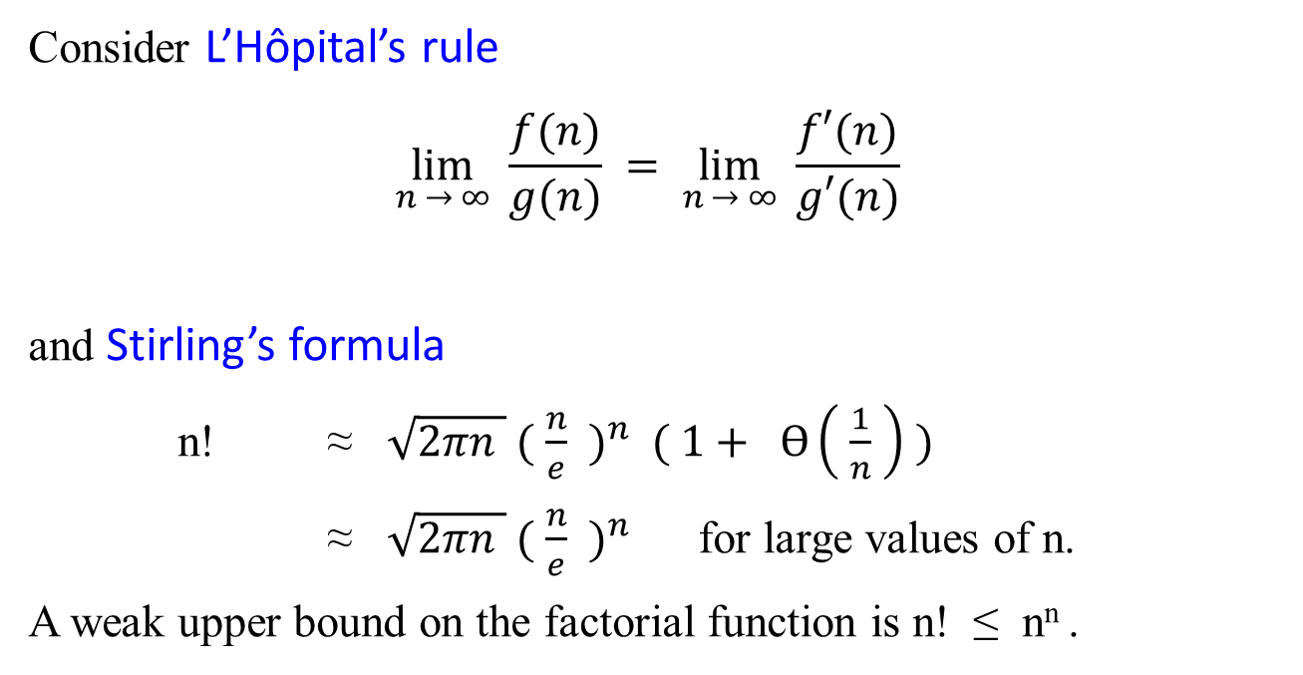
Consider L’Hôpital’s rule
$$\lim_{n → ∞}{\frac{f(n)}{g(n)}} = \lim_{n → ∞}{ \frac{f′(n)}{g′(n)}}$$
and Stirling’s formula
n! ≈ $\sqrt{2πn } {( \frac{n}{e} )}^{n} ( 1+ Ɵ\left( \frac{1}{n} \right) )$
≈ $\sqrt{2πn } {( \frac{n}{e} )}^{n}$ for large values of n.
A weak upper bound on the factorial function is n! ≤ n^{n} .

Slide 43

Examples: using the limit-based approach to comparing orders of growth of two functions:
Example 1.11: Compare the orders of growth of ½ n(n-1) and n².
$\lim_{n → ∞}{ \frac{ \frac{1}{2} n(n−1)}{ n^{2}} }$= $\frac{1}{2} \lim_{n → ∞}{\frac{n^{2}−n}{n^{2}}}$
= $\frac{1}{2} \lim_{n → ∞}{ ( 1− \frac{1}{n} )}$
= ½.
Since the limit is equal to a positive constant, the function have the same order of growth or, symbolically, ½ n(n-1) ε Ɵ(n²).

Slide 44

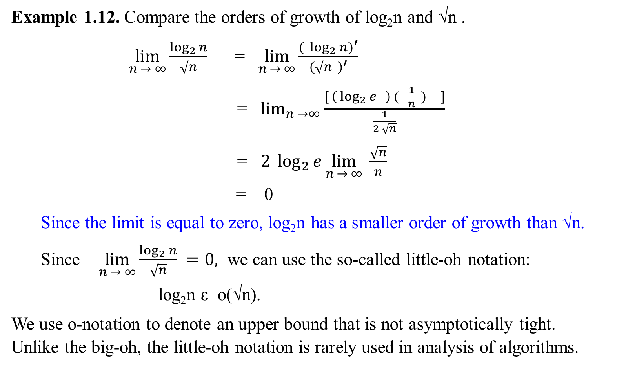
$${( \log_{2}{n})}^{′}$$
= $\left( \log_{2}{e} \right) ( \frac{n′}{n} )$
=$\left( \log_{2}{e} \right) ( \frac{1}{n} )$
Example 1.12. Compare the orders of growth of log₂n and √n .
$\lim_{n → ∞}{\frac{\log_{2}{n}}{\sqrt{n}}}$ = $\lim_{n → ∞}{\frac{{( \log_{2}{n})}^{′}}{{(\sqrt{n } )}^{′}}}$
= $\lim_{n →∞}{\frac{[ \left( \log_{2}{e} \right) ( \frac{1}{n} ) ]}{\frac{1}{2 \sqrt{n}}}}$
= $2 \log_{2}{e}\lim_{n → ∞}{\frac{\sqrt{n}}{n}}$
= 0
Since the limit is equal to zero, log₂n has a smaller order of growth than √n.
Since $\lim_{n → ∞}{\frac{\log_{2}{n}}{\sqrt{n}}} =0,$ we can use the so-called little-oh notation:
log₂n ε o(√n).
We use o-notation to denote an upper bound that is not asymptotically tight. Unlike the big-oh, the little-oh notation is rarely used in analysis of algorithms.

Slide 45
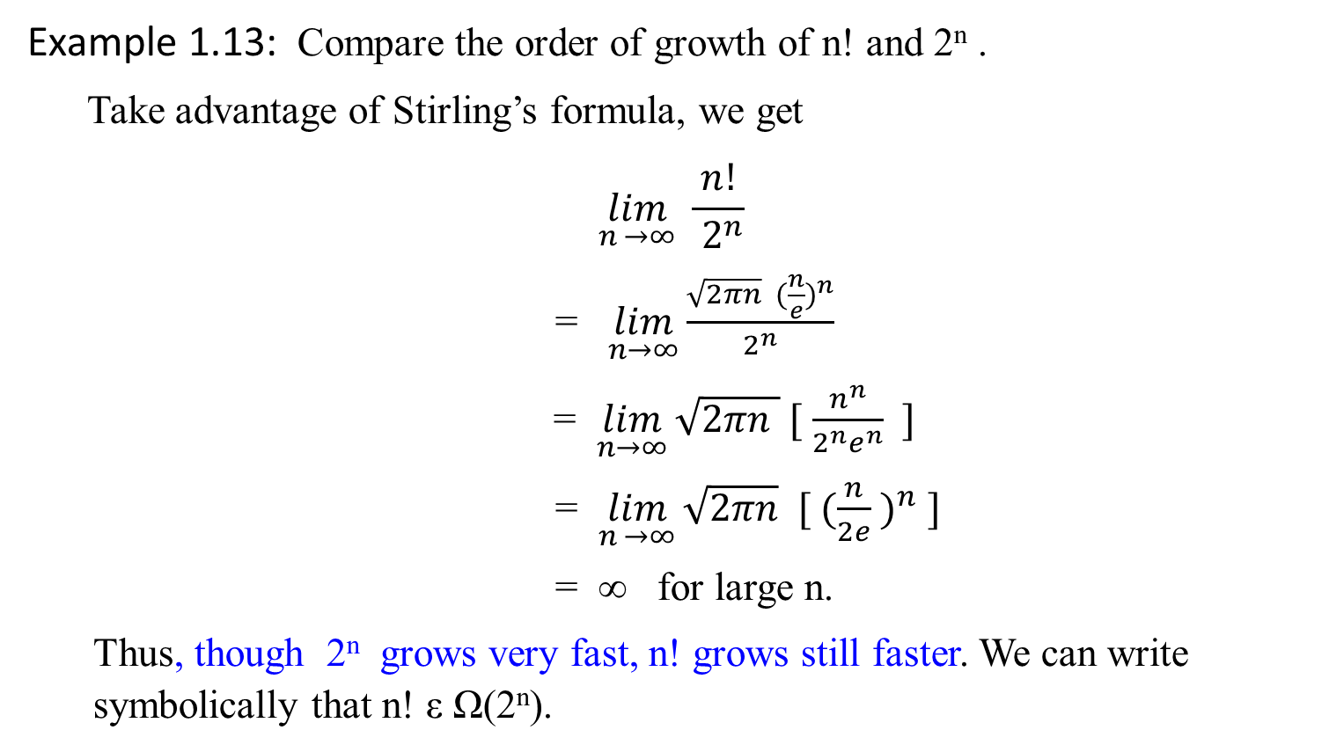
Example 1.13: Compare the order of growth of n! and 2^{n} .
Take advantage of Stirling’s formula, we get
$$\lim_{n →∞}{\frac{ n! }{{ 2}^{n}}}$$
= $\lim_{n→∞}{\frac{\sqrt{2πn} ({\frac{n}{e})}^{n}}{2^{n}}}$
= $\lim_{n→∞}{\sqrt{2πn } [ \frac{n^{n}}{2^{n}e^{n}} ]}$
= $\lim_{n →∞}{\sqrt{2πn} [ ({\frac{n}{2e} )}^{n} ]}$
= ∞ for large n.
Thus, though 2^{n} grows very fast, n! grows still faster. We can write symbolically that n! ε Ω(2^{n}).

Slide 46
Note:
while big-omega notation does not preclude the possibility that n! and 2^{n} have the same order of growth,
the limit computed here certainly does (preclude).

Slide 47
Class | Name | Comments / Table 1.2: Basis Efficiency Class
1 | Constant
log n | logarithmic | Result of cutting a problem’s size by a constant factor on each iteration of the algorithm. Binary search
n | linear | Algorithms that scan a list of size n belong to this class. Sequential search
nlogn | n-log-n | Many of divide-and-conquer algorithms, such as, merge sort, quicksort…
n² | quadratic | Two embedded loops algorithms; insertion sort; certain operation on n-by-n matrices.
n³ | cubic | Three embedded loops algorithms. Several nontrivial algorithms from linear algebra, such as multiply two n-by-n matrices by the definition-based algorithm.
2^{n} | exponential | Algorithms generate all subsets of an n-element set
n! | factorial | Algorithms generate all permutations of an n-element set

Slide 48
Table 1.3: Values (some approximate) of several functions important for algorithms’ analysis. See how the functions grow as n grows from 10, 10², … 10⁶.
n | log₂ n | n | n log₂ n | n² | n³ | 2^{n} | n!
10 | 3.3 | 10¹ | 3.3*10¹ | 10² | 10³ | 10³ | 3.6*10⁶
10² 10³ | 6.6 | 10² | 6.6*10² | 10⁴ | 10⁶ | 1.3*10³⁰ | 9.3*10¹⁵⁷
 | 10 | 10³ | 1.0*10³ | 10⁶ | 10⁹
10⁴ | 13 | 10⁴ | 1.3*10⁴ | 10⁸ | 10¹²
10⁵ | 17 | 10⁵ | 1.7*10⁵ | 10¹⁰ | 10¹⁵
10⁶ | 20 | 10⁶ | 2.0*10⁶ | 10¹² | 10¹⁸

Slide 49
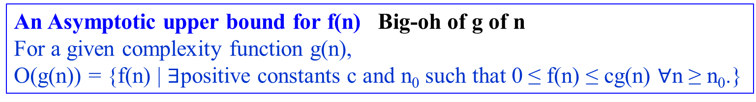
o-notation
The asymptotic upper bound provided by O-notation may or may not be asymptotically tight.
For example, The bound 2n² = O(n²) is asymptotically tight, but
the bound 2n = O(n²) is not.
Use o-notation to denote an upper bound that is not asymptotically tight.
Definition: little-oh of g of n
o(g(n)) = { f(n) | for any positive constant c > 0, there exists a constant
n₀ > 0 such that 0 ≤ f(n) < cg(n), for all n ≥ n₀.}
An Asymptotic upper bound for f(n) Big-oh of g of n
For a given complexity function g(n),
O(g(n)) = {f(n) | $∃$positive constants c and n₀ such that 0 ≤ f(n) ≤ cg(n) $∀$n ≥ n₀.}

Slide 50
Example 1.14:
Show that 2n = o(n²) but 2n² ≠ o(n²)
Proof of 2n² ≠ o(n²):
Assume that 2n² = o(n²). That means,
for any positive constant c > 0, there exists a constant n₀ > 0
such that 0 ≤ 2n² < cn² for all n ≥ n₀.
However, if c = 1, that 2n² < n² for all n ≥ n₀ is no longer valid.

Slide 51
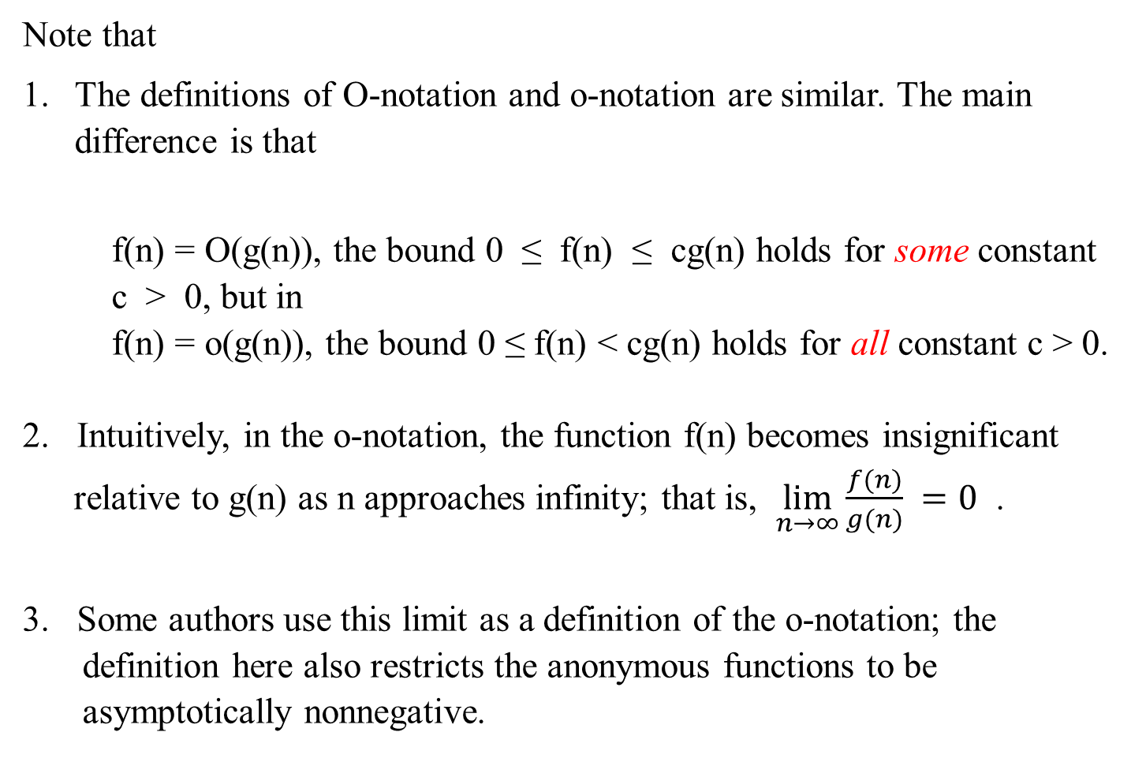
Note that
The definitions of O-notation and o-notation are similar. The main difference is that
f(n) = O(g(n)), the bound 0 ≤ f(n) ≤ cg(n) holds for some constant c > 0, but in
f(n) = o(g(n)), the bound 0 ≤ f(n) < cg(n) holds for all constant c > 0.
2. Intuitively, in the o-notation, the function f(n) becomes insignificant relative to g(n) as n approaches infinity; that is, $\lim_{n→∞}{\frac{f(n)}{g(n)}} =0$ .
3. Some authors use this limit as a definition of the o-notation; the definition here also restricts the anonymous functions to be asymptotically nonnegative.

Slide 52
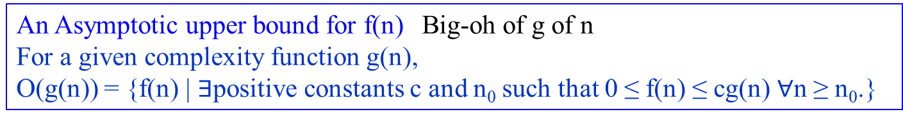
ω-notation
Use it to denote a lower bound that is not asymptotically tight.
Definition: little-omega of g of n
ω(g(n)) = { f(n) | for any positive constant c > 0, there exists a
constant n₀ > 0 such that 0 ≤ cg(n) < f(n), for all
n ≥ n₀.}
Another way to define it is by
f(n)ε ω(g(n)) if and only if g(n) ε o(f(n)).
An Asymptotic upper bound for f(n) Big-oh of g of n
For a given complexity function g(n),
O(g(n)) = {f(n) | $∃$positive constants c and n₀ such that 0 ≤ f(n) ≤ cg(n) $∀$n ≥ n₀.}

Slide 53
Example 1.15:
Show that n² / 2 = ω(n) but n² /2 ≠ ω(n²).
The relation f(n) = ω(g(n)) implies that
lim _{n → ∞} f(n)/g(n) = ∞,
if the limit exists.
i.e., f(n) becomes arbitrarily large relative to g(n) as n approaches infinity.
Proof of n² /2 ≠ ω(n²):
Assume that n² /2 = ω(n²). That means, for any positive constant c > 0, there exists a constant n₀ > 0 such that
0 ≤ c n² < n²/2 for all n ≥ n₀.
However, if c = 1, that n² < n²/2 for all n ≥ n₀ is no longer valid.

Slide 54
For the following, assume that f(n) and g(n) are asymptotically positive.
Transitivity:
f(n) = Ɵ(g(n)) and g(n) = Ɵ(h(n)) imply f(n) = Ɵ(h(n)).
f(n) = O(g(n)) and g(n) = O(h(n)) imply f(n) = O(h(n)).
f(n) = Ω(g(n)) and g(n) = Ω(h(n)) imply f(n) = Ω (h(n)).
f(n) = o(g(n)) and g(n) = o(h(n)) imply f(n) = o(h(n)).
f(n) = ω(g(n)) and g(n) = ω(h(n)) imply f(n) = ω(h(n)).

Slide 55
Reflexivity:
f(n) = Ɵ(f(n))
f(n) = O(f(n))
f(n) = Ω(f(n))
Symmetry:
f(n) = Ɵ(g(n)) if and only if g(n) = Ɵ(f(n))
Transpose symmetry:
f(n) = O(g(n))if and only if g(n) = Ω(f(n))
f(n) = o(g(n)) if and only if g(n) = ω(f(n))

Slide 56
Because these properties hold for asymptotic notations, one can drawn an analogy between the asymptotic comparison of two functions f and g and the comparison of two real numbers a and b:
f(n) = O(g(n)) ≈ a ≤ b
f(n) = Ω(g(n)) ≈ a ≥ b
f(n) = Ɵ (g(n)) ≈ a = b
f(n) = o(g(n)) ≈ a < b
f(n) = ω (g(n)) ≈ a > b
We say that
f(n) is asymptotically smaller than g(n) if f(n) = o(g(n)).
f(n) is asymptotically larger than g(n) if f(n) = ω (g(n)).

Slide 57
One property of real numbers does not carry over to asymptotic notation:
Trichotomy: For any real two real numbers a and b, exactly one of the following must hold:
a < b, a = b or a > b.
Although any two real numbers can be compared, not all functions are asymptotically comparable.
That is, for two functions f(n) and g(n), it may be the case that
neither f(n) = O(g(n)) nor f(n) = Ω(g(n)) holds.
For example:
the functions n and n^{1+sin n} cannot be compared using asymptotic notation,
since the value of the exponent in n^{1+sin n} oscillates between 0 and 2, taking on all values in between.

Slide 58
Recall the definitions:
1. For a given function g(n),
Ɵ(g(n)) = {f(n) | there exist positive constants, c₁, c₂ and n₀
such that 0 ≤ c₁g(n) ≤ f(n) ≤ c₂ g(n), for all n ≥ n₀ }.
2. For a given function g(n),
O(g(n)) = {f(n) | there exist positive constants c and n₀
such that 0 ≤ f(n) ≤ cg(n), for all n ≥ n₀.}
3. For a given function g(n),
Ω(g(n)) = {f(n) | there exist positive constants c and n₀
such that 0 ≤ cg(n) ≤ f(n), for all n ≥ n₀ }.
…

Slide 59
Recall the definitions:
1. …
4. For a given function g(n),
o(g(n)) = {f(n) | for any positive constant c > 0, there exists a constant
n₀ > 0 such that 0 ≤ f(n) < cg(n), for all n ≥ n₀.}
5. For a given function g(n),
ω(g(n)) = {f(n) | for any positive constant c > 0, there exists a constant
n₀ > 0 such that 0 ≤ cg(n) < f(n), for all n ≥ n₀.}

Slide 60
Background:
Standards, Notations,
and Common Functions

